Slide 1
Ex. Responsive band Webpage
Design for Mobile First | Tablet Design | Desktop Design | Supporting Multiple DPRs
Notes:
Welcome to our lecture on Example of a responsive band webpage. In this lecture we will go through how to design webpage for mobile, Tablet and desktop, and finally we will look into design pixel ratios. Let’s start our lecture.

Slide 2
Design for Mobile View
Mobile-First Design: Start with a single-column layout optimized for mobile devices and progressively enhance for larger screens.
Responsive Grid Layout: Use a grid to position the header, members, concerts, and contact information efficiently.
Tablet and Desktop Layout: Adjust the grid to use 2 columns for improved spacing and readability on larger screens.
Notes:
Designing for mobile view starts with a mobile-first approach, using a single-column layout optimized for smaller screens and progressively enhanced for larger ones. A responsive grid layout positions elements like the header, members, concerts, and contact information. For tablets and desktops, the grid adjusts to two columns for better spacing and readability on larger screens.

Slide 3
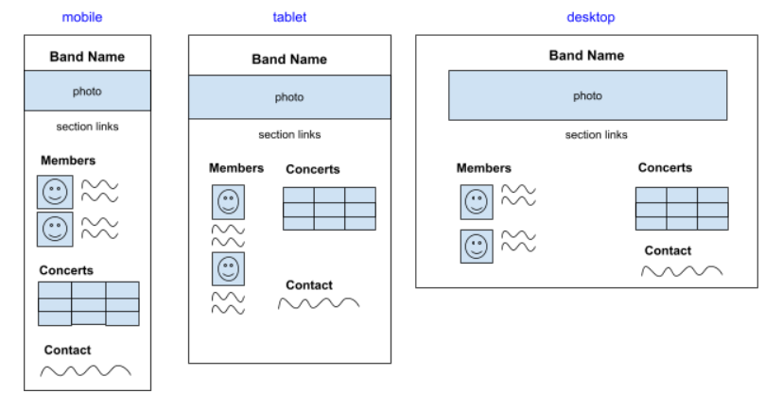
Mobile, tablet, and desktop wireframes
Notes:
These wireframes show responsive designs for mobile, tablet, and desktop views. The mobile design uses a single-column layout to stack all sections vertically. For tablets, the layout adjusts to two columns, placing concerts and contact next to members for better use of space. On desktops, the layout further optimizes spacing, keeping sections like members, concerts, and contact aligned in rows.

Slide 4
Design for Tablet View
Tablet Layout: Concerts and Contact appear beside Members, with lists moved below each photo. Adjusts layout for browsers with a minimum width of 600px:
Grid Adjustment: The <body> grid changes to 2 columns, placing Concerts and Contact beside Members.
Flexbox Update: The band-member container switches to column direction, moving lists below photos.
Notes:
In the tablet layout, concerts and contact sections are placed beside the members section, with lists moved below each photo. The grid adjusts to two columns in the body, positioning concerts and contact next to members. The band member container switches to column direction, ensuring lists appear below photos. This layout is optimized for devices with a minimum width of six hundred pixels.

Slide 5
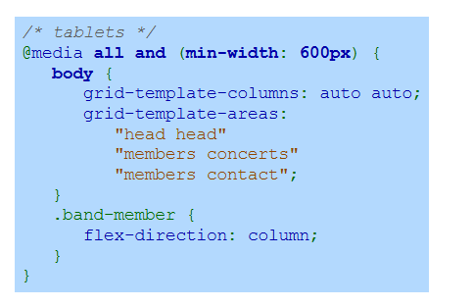
Media Query for Tablet
Notes:
This media query targets devices with a minimum width of six hundred pixels for tablet layouts. The body grid adjusts to two columns, defining areas for the head, members, concerts, and contact sections. The band member container changes its flex direction to column, ensuring that lists are positioned below the respective photos. This layout improves readability and organization on tablet screens.

Slide 6
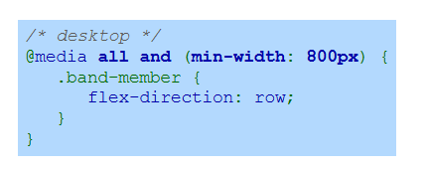
Desktop Design
Desktop Layout: Member lists appear to the right of photos on wider screens.
Media Query: Adjusts band-member container to arrange items in a row for browsers 800px or wider.
Media Query for Desktop Design:
Notes:
In the desktop design, member lists are positioned to the right of photos on wider screens. A media query adjusts the band member container to arrange items in a row for browsers with a minimum width of eight hundred pixels. This layout optimizes space and enhances readability on larger screens, creating a clear and organized display for desktop users.

Slide 7
Multiple DPRs
Multiple Resolutions: Three images are created at different resolutions for each band member.
Responsive Images: The srcset attribute ensures the appropriate image is downloaded based on the device's DPR.
Optimized Display: Delivers sharp and optimized images for all devices, including high-resolution screens.
Notes:
To support multiple device pixel ratios, three images are created at different resolutions for each band member. The source set attribute ensures that the appropriate image is downloaded based on the device pixel ratio. This approach delivers sharp and optimized images for all devices, including high-resolution screens, enhancing the visual experience across varying displays.

Slide 8
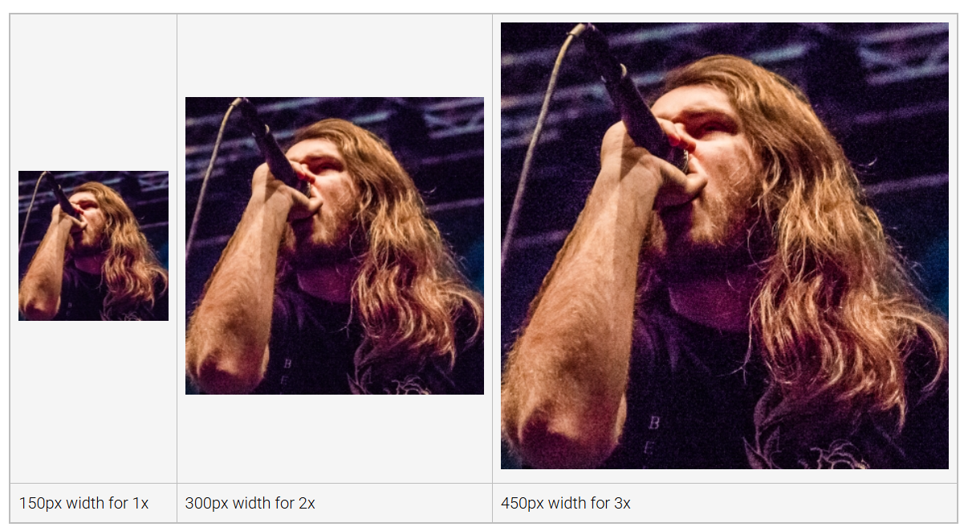
Member Images for Various DPRs
Notes:
This slide illustrates images prepared for various device pixel ratios. For devices with a one times ratio, a one hundred fifty pixel width image is used. For two times devices, a three hundred pixel width image is displayed. High resolution devices with three times ratio use a four hundred fifty pixel width image. This ensures sharp visuals tailored to each device's display capabilities. Thanks for watching the lecture.

